Slide 1

Housing Prices New York City
By
Pizon Shetu

Slide 2

Problem Statement
How do we engage the New York City housing market?
How should Capital Fortune price their homes?

Slide 3

Predicting House Prices
How machine learning can help predict prices of homes in New York City
Zillow’s NYC Dataset

Slide 4
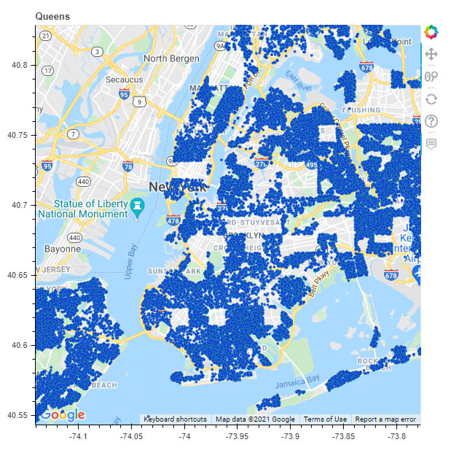
Homes in dataset

Slide 5
Data Wrangling
75,000 observations with over 1500 features
Shrunk to 65,000 homes and 24 features
Main variable – Price
Dropping of redundant, useless features and rows with missing values

Slide 6
Imputations - MICE
Imputation method utilizing Gradient Regression on missing values
Estimates missing value of one feature by learning from other features and looking at past values given data from other features.
6 Step process
Greater results than mean or median imputation.

Slide 7
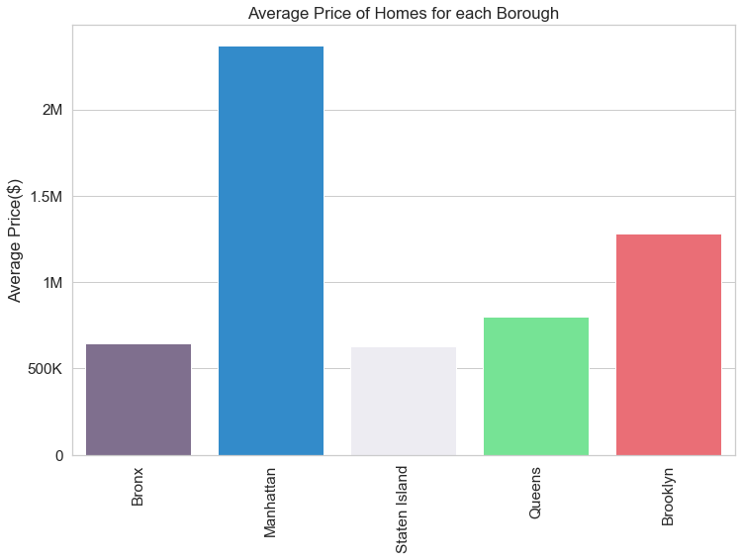
Location Impact
Manhattan has the highest average prices for homes

Slide 8
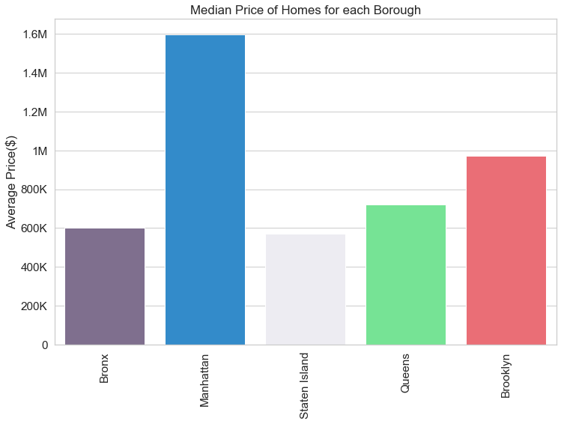
Median Price of Homes
Average Price of homes can be skewed by outliers, Median shows how much most houses are sold for.

Slide 9
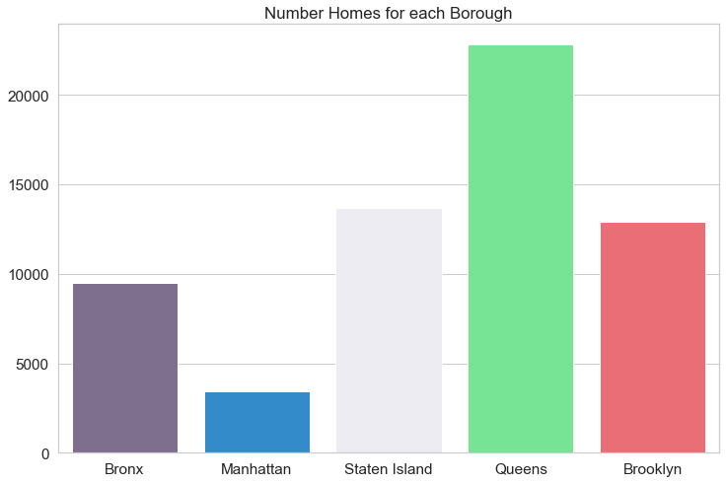
Location count
Manhattan barely having many homes for sales compared to other boroughs
Queens leading in home listings

Slide 10
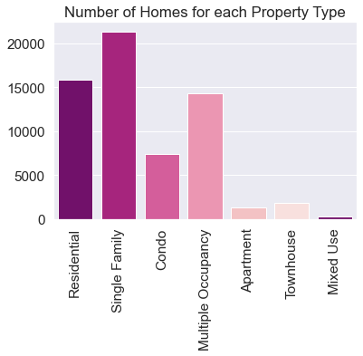
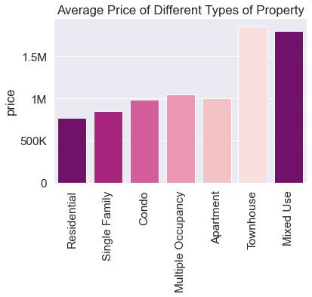
Property Type
Due to low sample size data for Townhouse and Mixed Use properties, we can have skewed data, as few homes might not give us the whole picture for prices for this property type.

Slide 11
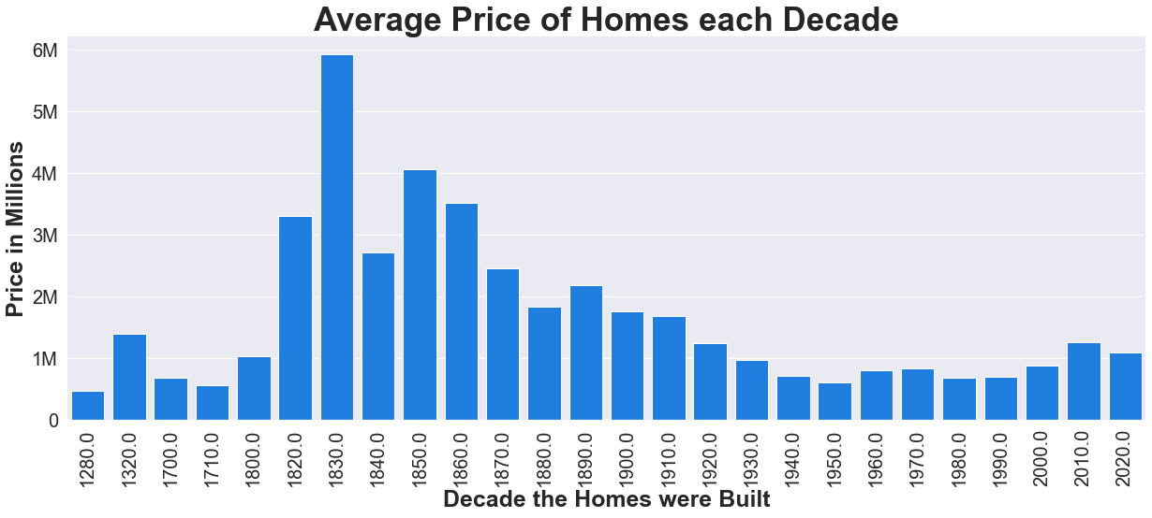
Impact of Built Year
70 % of homes in early 1800’s to 1900’s were in Manhattan or Brooklyn
Recent Homes see an uptick with over 50% of homes in lower priced boroughs

Slide 12
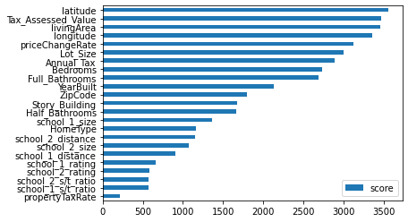
Most Impactful Features

Slide 13
Metrics for evaluation
MAE – Mean Absolute Error
On average how far is the prediction from the actual

Slide 14
Model Selection
Linear Regression
380K
K-Nearest Neighbor
261K
RandomForest
250K
XGBoost Regression
220K

Slide 15
Hyper-Parameter Tuning
Max_depth, min_child_weight, eta, subsample, and col_sample
Reduction of nearly 30K in MAE on testing data and 65.7K in training data.

Slide 16
Takeaways
Best results achieved via XGBoost
Location is the largest driving force of price
Multi-family homes and Condominium have greater returns
Townhouses yield a high price but due to lack of data it is inconclusive
Newly built homes garner larger premium over old and remodeled homes

